Slide 1
TK2100: Informasjonssikkerhet Lesson 01: Introduction
Dr. Andrea Arcuri
Westerdals Oslo ACT
University of Luxembourg

Slide 2



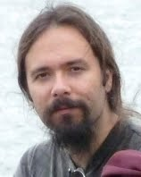


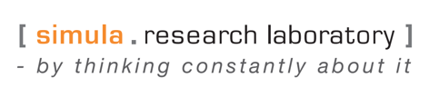

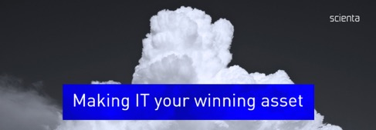

About Me
Dr. Andrea Arcuri

Slide 3
Goals
Learn the basics of Information Security
Cryptography and secure communications
Operating Systems
Malwares
Network Security
Web Security

Slide 4
Course Info
12 lessons, once a week
Check TimeEdit for possible changes of time and rooms
4-hour lectures
Between 1 and 2 hours of teaching
Remaining time is for exercises and questions
See TimeEdit for the rooms, which might vary each week
Exam: 3 hour written exam
Note: as teaching this course for first time, and updating it compared to previous years, haven’t decided yet the details of the exam

Slide 5
Theory vs Practice
This course starts with more focus on the “theoretical” side
as you are 1st year students still learning how to code…
eg, complex topic, and can’t really ask you to write a malware when you still have problems writing a “for-loop”…
Practice on using some existing tools, not how to integrate them in existing applications
for that, you ll need to wait for Enterprise 1-2 (for Programmering students)
Last part of the course on Web Security will have more focus on coding compared to the beginning of the course

Slide 6
Course Material
Its Learning page for TK2100
Git repository (more on this later in the slides)
https://github.com/arcuri82/tk2100
Book: Introduction to Computer Security: International Edition
Good book which you will need also in the future
STRONGLY recommend you to get a copy

Slide 7
Contact
Do NOT send me private emails
You are around 200 students…
If you have questions outside class, post them on the “Discussion forum” on the Its Learning page of this course

Slide 8
Why studying Information Security???

Slide 9
2013-2014:
3 Billions accounts compromised
yes, it is Bs, not Millions
Stealing information is bad, especially if credit card numbers
But what is another major issue? People re-use same password for different sites, eg Gmail, Facebook, etc.
Yahoo had easy to crack hashed passwords (eg, MD5)
How many of you use a different password for each different service???

Slide 10
2016: Adult Friend Finder
Web site for “hook-ups”
412 million accounts were compromised
Users got blackmailed
eg, people cheating on spouses
some even committed suicide…

Slide 11
2014: eBay
145 million accounts compromised
But fortunately credit card numbers were stored in different databases

Slide 12
2017: Equifax
143 million consumer info breached
Personal information
including Social Security Numbers, birth dates, addresses, and in some cases drivers' license numbers
209,000 consumers also had their credit cards exposed

Slide 13
2011: Sony's PlayStation Network
77 million accounts hacked
12 million unencrypted credit card numbers got stolen
Site down for a month
Around $200 million in losses

Slide 14
And the list goes on…
Could go on all days with examples of compromised web sites where user info was stolen…
But stealing of info (eg credit cards and passwords) is not the only thing you should be concerned about security…

Slide 15
Web Defacement
Hack into a website and change its content
Religious, governments and corporations are typical targets
Usually for political reasons, or bored “kids”…

Slide 16
Malware
Malicious Software
Code that execute on your machine could do anything
Allow remote control
Log keystrokes to steal passwords
Etc.
Usually received via emails or downloads from shady websites…
Virus: can replicate themselves, and spread to other users, eg via email

Slide 17
Ransom-ware
A special kind of malware
It encrypts your hard drive, and ask ransom to decrypt it
usually asked payment in BitCoins
2017: 16 hospitals hit in UK
hospitals are typical targets, because have critical data of patients on life-or-death conditions

Slide 18
DDOS
Distributed Denial of Service
Overload servers with “time-consuming” requests
So many requests that web site goes “down”, as not enough resources to establish new connections for regular users
Malware: infected machines can work as “bots” and take part in these DDOS, ie distributed

Slide 19
Phishing
Obtain sensitive data by by disguising as a trustworthy entity
Typically email with link to a known site (eg your bank), but such link go to a malicious one looking same as original

Slide 20
HTML Injection
If accessing a web site is un-encrypted (ie, HTTP instead of HTTPS), any entity between you and the server can alter the data
Eg, accessing internet via WiFi in an hotel or restaurant
Why altering a HTML page?
eg, add advertisement or crypto-miners

Slide 21



The Enemy
Not only typical organized crime
Foreign government organizations
NSA (USA), and equivalents in Russia, China, UK, etc
Being “allied” nations does not prevent their criminal activities

Slide 22
Security Foundations

Slide 23
What is Information Security?
A system, application, or protocol is only safe in relation to:
Predefined, desired properties
An opponent with specified abilities and characteristics
Example: Access to a Windows machine is not secure for anyone who has physical access to it and can boot it.

Slide 24


C.I.A. Concepts
Integrity
Confidentiality
Availability

Slide 25
CIA: Confidentiality
Avoidance of unauthorized disclosure of information
Authorized users should be able to read the data…
… whereas unauthorized should not
Typically trying to keep data “secret”

Slide 26
Cyphers during Roman Empire
Communications to generals in the army should be kept secret
Even if messages get caught by the enemy
Substitution cyphers, mapping for each letter, eg D -> A, E -> B, etc.
Trivial to break nowadays
But shows security was important already 2000 years ago…

Slide 27
WW2: Enigma
Used by Nazis to make their messages secret
The “breaking” of this code was a major development for the victory of the allied forces
Good movie: “The Imitation Game”

Slide 28
Confidentiality Tools
Encryption
Access Control
Authentication
Authorization
Physical Security

Slide 29
Confidentiality: Tool 1
Encryption: The conversion of information by secret (encryption key) so that the encrypted message (ciphertext) can only be read / seen with the help of another secret (decryption key)
Encryption and decryption keys may be the same or different
Sender
Communication channel
Recipient
encrypt
decrypt
ciphertext
plaintext
plaintext
shared secret key
shared secret key
Attacker (eavesdropping)

Slide 30
Confidentiality: Tool 2
Access Control (AC)
Rules and policies that restrict access to confidential information
Applies to both individuals and computer systems
Can be controlled by identity (name), MAC address, or role (CEO, employee, employee PC, system administrator, ...)

Slide 31
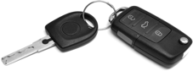


Confidentiality: Tool 3
Authentication
Determine the identity or role of someone
Can be done in several ways but is usually based on a combination of:
Something one person has: smart card, cell phone, HW key ...
Something a person knows: password
Something a person is: fingerprints, irises.
Radio token with secret key
Something you have
passord=ucIb()w1V
mor=Godhjerta
årstall=1984
Something you know
Human with fingers and eyes
Something you are

Slide 32
Example: 2-phase authentication with Mobiles
IMSI = (this phone’s ID)
R = a 128-bit random number (the challenge)
E_{K}(R) = the 128-bit random number encrypted
using the subscriber’s secret key K
(the response)
Eg, based on the phone’s hardware id, IMSI (International Mobile Subscriber Identity)

Slide 33



Example: Fingerprints
Reader
Biometric
Feature vector
Comparison algorithm
Reference vector
matches
doesn’t match
Eg, used to activate mobile without pin code

Slide 34
Confidentiality: Tool 4
Authorization
Once authenticated, determine which resources a person / system will have access to, based on the access policies
Should prevent the attacker from tricking the system to allow him access to protected resources.

Slide 35
Confidentiality: Tool 5
Physical Security
Establish physical barriers that restrict access to protected data resources.
eg, locks on doors
eg, place servers in rooms without windows eg, soundproofing materials
eg, Faraday cages (radio wave isolation)
etc.

Slide 36
C.I.A.: Integrity
Information not altered in unauthorized ways
Alterations in data are not always malicious, eg Telephone Game

Slide 37
Integrity Tools
Confidentiality: authentication/authorization to avoid malicious actors altering the data
Backups: periodic archiving of data. If data compromised, can be restored
Checksums: mathematical mapping from whole data to a single number. If data is altered, mapped number might change, and so detect the alteration
Data correcting codes: redundancy systems in which small changes can be automatically detected and corrected

Slide 38
C.I.A.: Availability
Information should be accessible in timely fashion by those authorized
Most secure computer is one that it is not connected to internet, switched off and unplugged…
… but data in it would not really be so accessible…

Slide 39


A.A.A. Concepts
Authenticity
Anonymity
Assurance

Slide 40
Assurance
Assurance is about how trust is established and managed in computer systems
very hard to quantify
Trust management involves:
Policies: specifies expected behavior from people and systems
eg, iTunes specifies how users access and can copy / share intellectual property
eg, Facebook's rules on what is acceptable behavior and what can be published
Permissions: describes what behaviors are permissible / allowed for those who use the system
eg, iTunes permissions/limitations on copying movies / songs.
Protections: describes which mechanisms are used to enforce the policies and permissions
eg, DRM for copy protection

Slide 41

Authenticity
Ability to determine whether statements, policies and permissions issued by a person / system are genuine (not forged)
Primary mechanism: digital signatures
Cryptographic computations that allow people / systems to commit to the authenticity of their documents in a unique way that achieves non-repudation

Slide 42
Anonymity
Property that certain records or transactions are not to be attributable to any individual
Corporations want your history and personal info
eg, to sell targeted ads
eg, to avoid providing insurance to high-risk individuals
Government agencies can track your online activities
see Tor Browser

Slide 43
Ten Security Principles
Security Principles
Economy of mechanism
Fail-safe defaults
Complete mediation
Open design
Separation of privilege
Least privilege
Least common mechanism
Psychological acceptability
Work factor
Compromise recording

Slide 44
1: Economy of mechanism
As simple design and implementation of security measures as possible
Applies to all software development, not just security
Particularly important for security reasons
Easier to find errors and prevent critical bugs
Note: used solutions can be very complex (eg, cryptography), but should use existing libraries, not develop your own

Slide 45
2: Fail-safe defaults
Default settings in applications and systems should be conservative
eg., a newly created user should have only limited privileges
Privileges should be explicitly granted, and not be on by default
eg., execute code downloaded from internet
Problem: many applications favors usability over security

Slide 46
3: Complete mediation
Every access to a resource should be checked for compliance
Possible performance issues, and usability concerns
Can have timeouts
eg, once logged in, allow operations for 15 minutes before asking for login/password again

Slide 47
4: Open Design
Security algorithms should be open, and not secret
Open implementations lead more people reviewing the code and find issues
What kept secret should be the keys used in these algorithms, not the algorithms themselves
Opposite of “Security by Obscurity”, which traditionally has been very poor

Slide 48
5: Separation of privilege
Multiple conditions required for access
Eg, instead of permissions to access all resources, can have permissions for X that are different than for Y
Separation of components: a component that can access X, should not access unrelated Y. If compromised, only X would be accessed

Slide 49
6: Least privilege
Users should have only the minimum privileges to do the operations s/he needs
If user/application does not need to work on X, should not have access to X
eg, usually a mobile app game should not need to send SMS
Reason: if a machine is comprised, only the minimum amount of resources can be altered/exploited

Slide 50
7: Least common mechanism
Resource sharing should be minimized
Shared resources is a way in which information can be transferred
Problem when resource sharing involves confidential information by mistake

Slide 51
8: Psychological acceptability
User interfaces (UI) should be well designed
Confusing UI shouldn’t lead to misconfigure security settings
If security of an application is hard to configure, users will not use it
eg, email encryption

Slide 52
9: Work factor
Choice of security measures should take into account the type of resources
Eg, an online bank needs more security than a web forum

Slide 53
10: Compromise recording
Sometimes more cost-effective to record details of attack than using more complex techniques to prevent it
Tradeoff: might not be able (or be too expensive) to prevent all attacks, but at least should know when one happens

Slide 54
Steganography

Slide 55


What is the difference between these 2 pictures?

Slide 56


Hidden Message
The first is a picture of a cute cat
The second is a picture of a cute cat, but with the text “A secret message” hidden in it using steganography
But where is the text hidden???

Slide 57
Image formats
There are many image formats: JPEG, PNG, BMP, etc.
For simplicity, let’s just consider an image as a bitmap, ie a composition of pixels, where each pixel has a color
The color of each pixel is represented with a number
Image file is a sequence of bits 0/1, like any other file

Slide 58
RGB: Red, Green and Blue
A color can be represented with a composition of Red, Green and Blue
Each base color has an intensity, eg from 0 to 255
Each color can be represented has a composition of Red, Green and Blue
Black: (0,0,0) no red, no green, no blue
Red: (255, 0, 0) full red, no green, no blue
Yellow: (255, 255, 0) full red, full green, no blue
Grey: (127,127,127) all 3 having same value
White: (255, 255, 255) all full

Slide 59
RGB: Cont.
If each intensity has 256 different values, can represent it with 8 bits, 2^8=256
Each RGB pixel would have 3*8=24 bits
So 2^24=16,777,216 possible different colors
A 1000x1000 pixel image would be 24M
Note: most image formats are compressed and would need less space

Slide 60
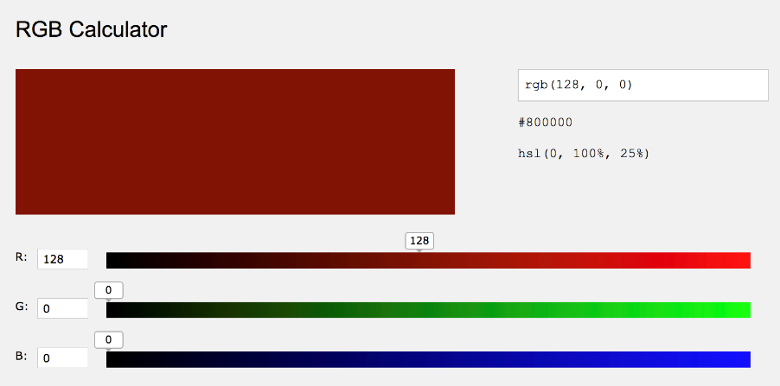
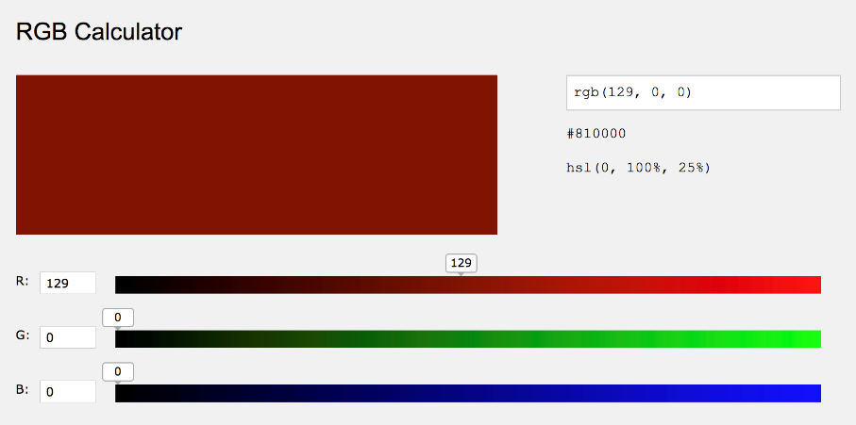
Can you see the difference?
Small changes in color intensity might not be detectable with your eyes

Slide 61
Image bits 0/1
Each pixel is going to be 24 bits
Use 23 bits for color, and 1 bit for your data
23 bits: 8 millions instead of 16 millions
Image reader would still read 24 bits per pixel
23+1 bits should be similar (at times the same) color to the original 24 bit one
Human eye would likely not notice the difference
If using ASCII with 7 bits per letter, can have one character per pixel
“A secret message” is 16 chars, so can be hidden in a 16*7=112 pixel image

Slide 62
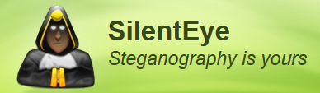
Steganography Tools
Hide messages/images/videos inside other messages/images/videos
As you are 1st year student, we will not see the code of how to do it
SilentEye is one existing tool
http://silenteye.v1kings.io/

Slide 63
Git and GitHub

Slide 64
Git
Git is a tool to share code among different developers in the same project
Also useful for single developers to keep track of changes, and automatically have backups on remote servers
You will see the details of Git in other courses…
… but I am using Git to handle files in this course (eg exercises), so need to start to get used to it
Note: usage of Git will NOT be part of the exam…

Slide 65
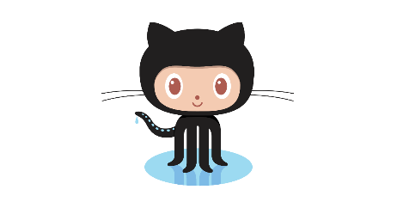
GitHub
Currently the main server repository for hosting open-source projects
Before, the main one was SourceForge
GitHub provides a website in which projects can be browsed
Projects on GitHub are handled with Git
GitHub is most famous/used, but there are others as well
eg, BitBucket and GitLab

Slide 66
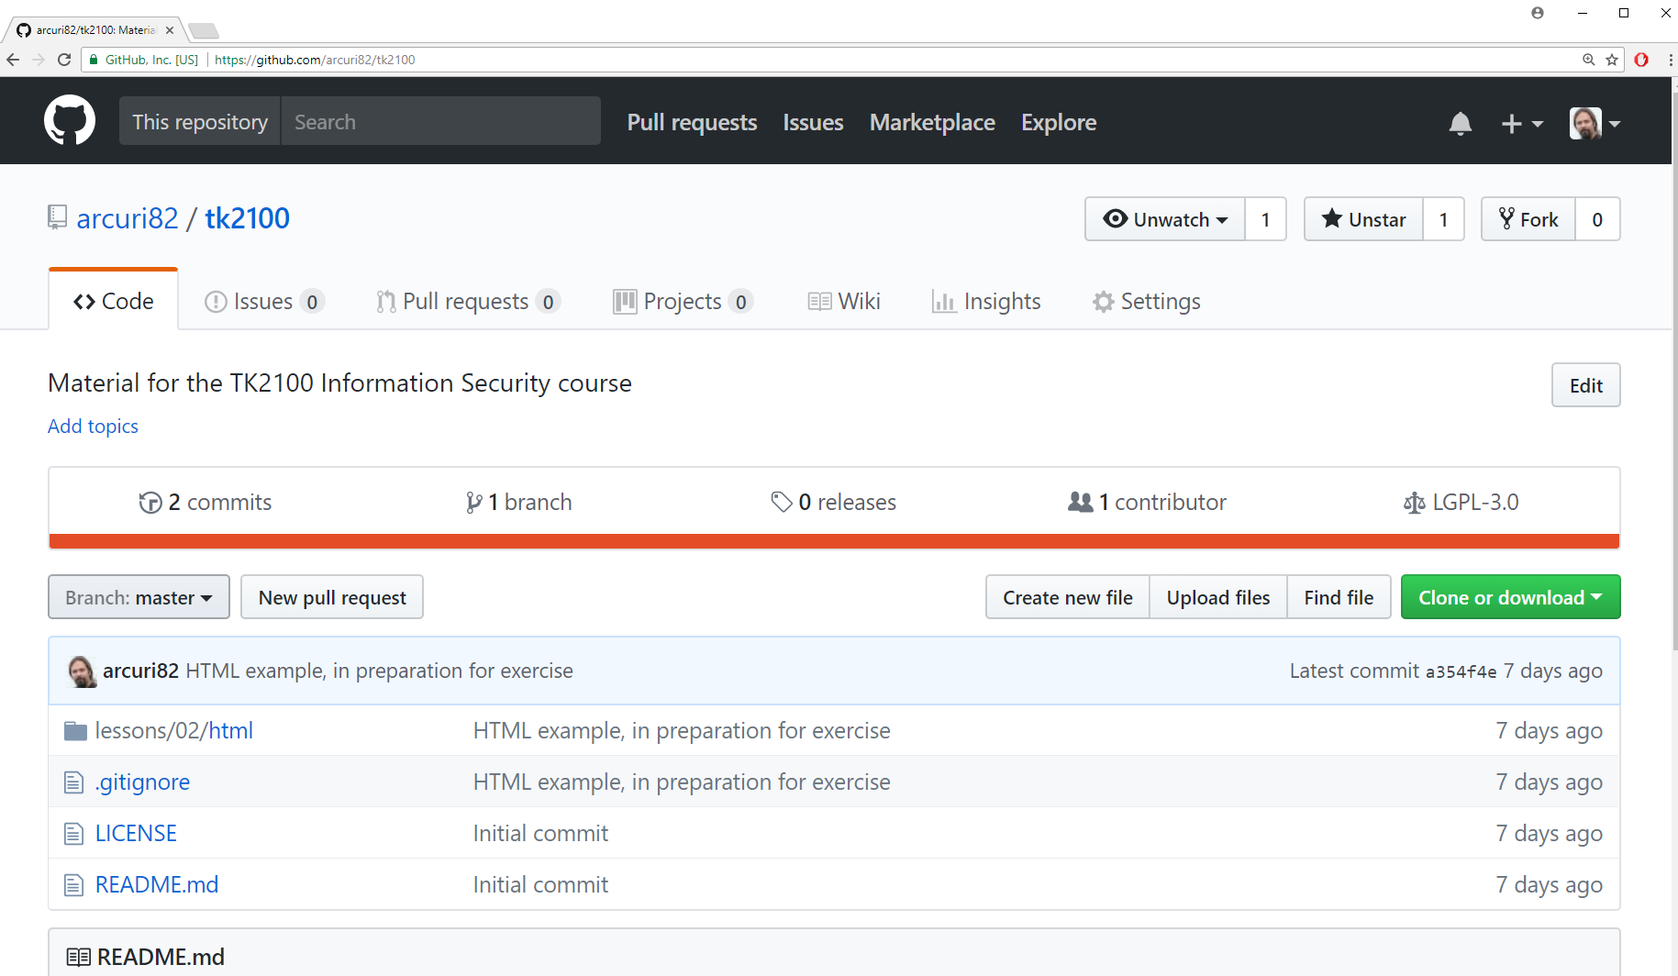
https://github.com/arcuri82/tk2100
Note: still under development, as not re-using material from previous years…

Slide 67
What you need to know/do…
For now, you can just access the website of GitHub directly
Once you learn Git details in other courses, and you install Git on your machine, can clone repository to your local machine
“git clone https://github.com/arcuri82/tk2100.git”
make a copy of the repository on your hard-drive
“git pull”
update your local copy with the latest changes in the repository
Those commands can be run from command line, or from your IDE (eg, IntelliJ and WebStorm)

Slide 68
For Next Week
Book pages: 2-16
Note: when I tell you to study some specific pages in the book, it would be good if you also read the other pages in the same chapter at least once
Note: steganography is not in the book
Exercises for Lesson 01 on GitHub repository

